Slide 1

Humane Society Animal Tracking System – A Case Study
Nicholas C. DeSteffen
Department of Mathematics and Computing
University Wisconsin – Stevens Point

Slide 2
Analysis
Current System
  Nutshell – DOS based DBMS
  Hand Generated Reports
  Data stored in binders
Rational Rose

Slide 3
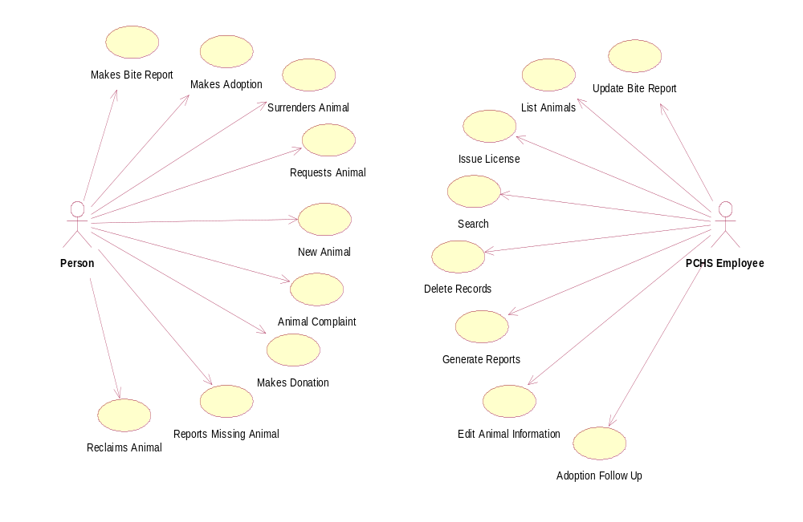

Slide 4
Requirements
Track all incoming and outgoing animals
Edit information about all animals
Track animals reported missing
Notify employee of request matches
Track donations made
Handle distribution of cat and dog licenses
Record animal bite reports
Record animal complaints
Perform financial transactions
Perform basic reporting functions
Automatically generate webpage with current
animal listing

Slide 5
Design
Front End – Microsoft Visual Basic 6.0 Interface
Back End – Microsoft Access 2000 Database
Reporting and Forms – Seagate Crystal Reports 8.0
Web Page - ASP

Slide 6
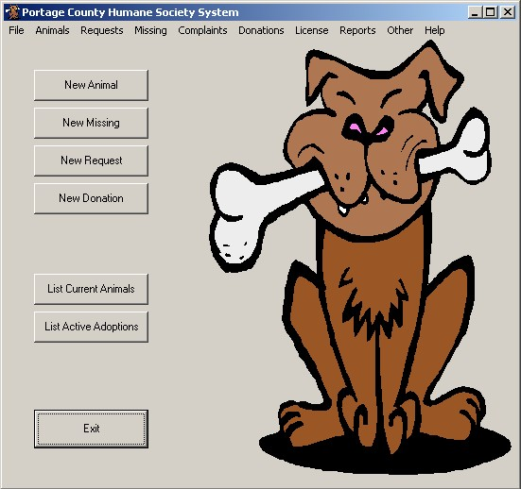
Main Navigation Form

Slide 7
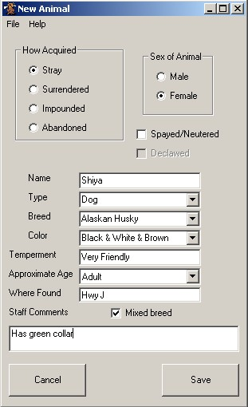
New Animal Process

Slide 8
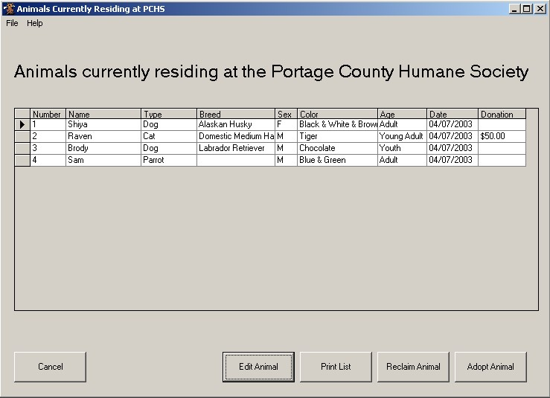
Current Animal Listing

Slide 9
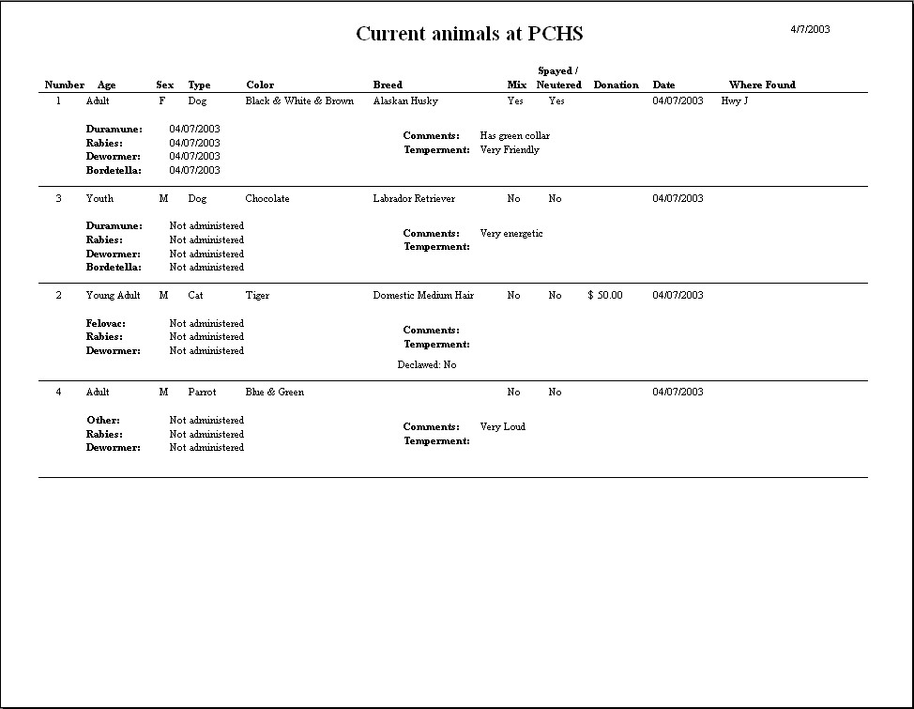

Slide 10
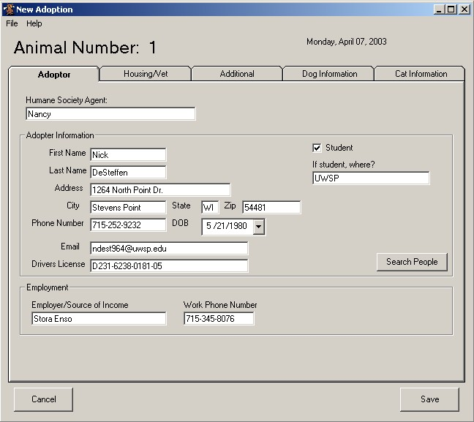
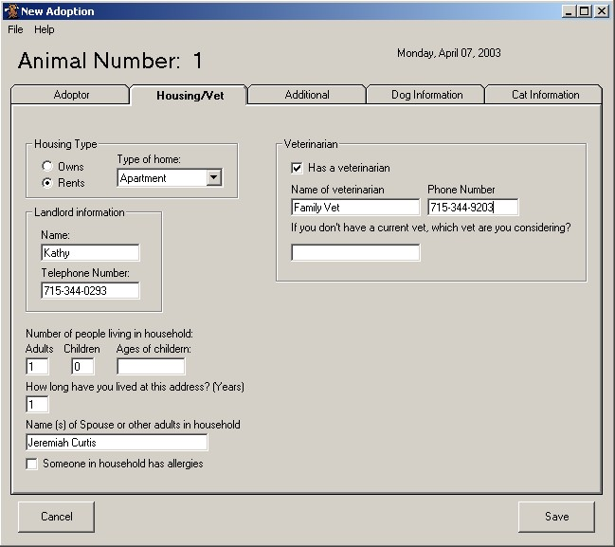
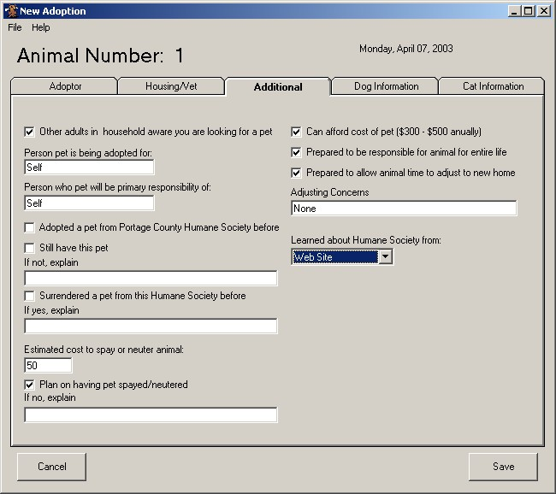
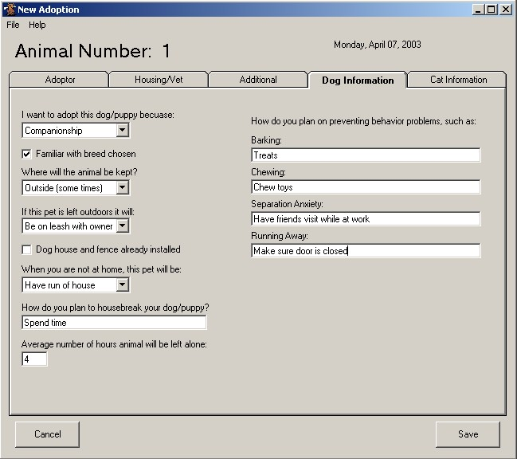
Adoption Process

Slide 11
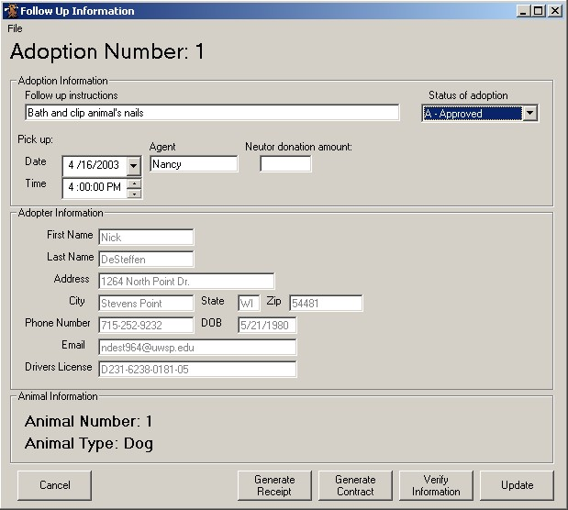
Adoption Follow up

Slide 12
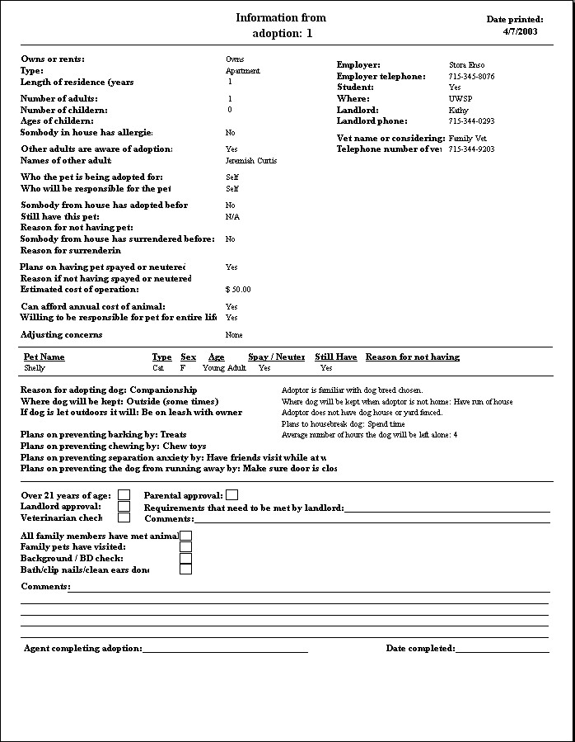

Slide 13
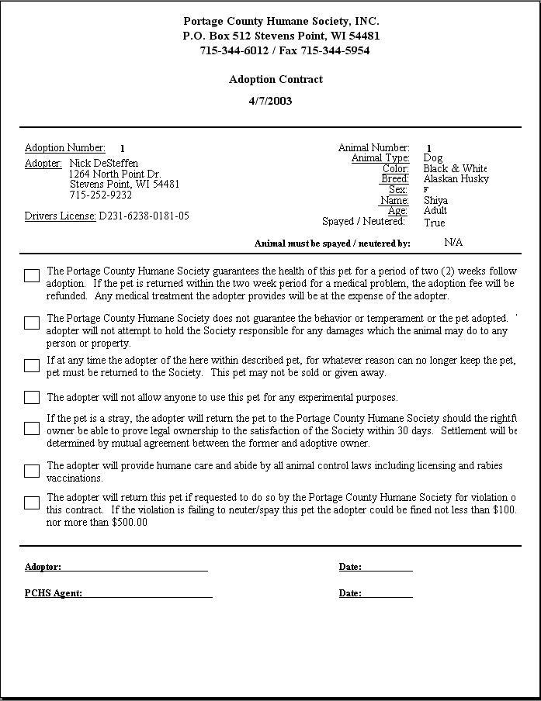

Slide 14
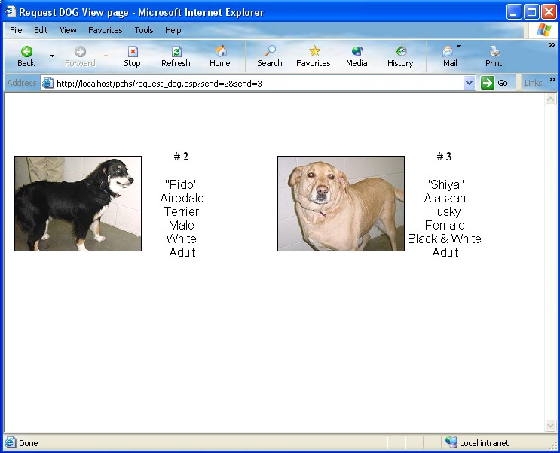
Web Generated Animal Listing

Slide 15
The End
Acknowledgments
Mentor
Daniel Goulet, Professor
Department of Mathematics and Computing
University of Wisconsin – Stevens Point
Team Members
Kalonji Kadima
Yong-Soo Jeon

